Slide 1

Insight System
Crispino, Zyrus
CPE31
A Machine Learning System for Predicting Team Win Rates, Character Builds, and Individual Performance in Eternal Return

Slide 2

Introduction
Eternal Return is a MOBA–battle royale hybrid game with 80 characters, each with unique builds.
Players must optimize team composition, character performance, and item builds to improve win rates.

Slide 3

Introduction
Decision-making in the game is complex due to the dynamic meta and diverse character interactions.
This project aims to assist players by applying machine learning to analyze past matches and generate strategic recommendations.
The system consists of three core models: Team Win Prediction, Character Performance Evaluation, and Character Build Recommendation.

Slide 4

Objectives
Predict Team Performance
Predict Character Suggested Builds
Predict Individual Character Performance

Slide 5
Methodology

Slide 6
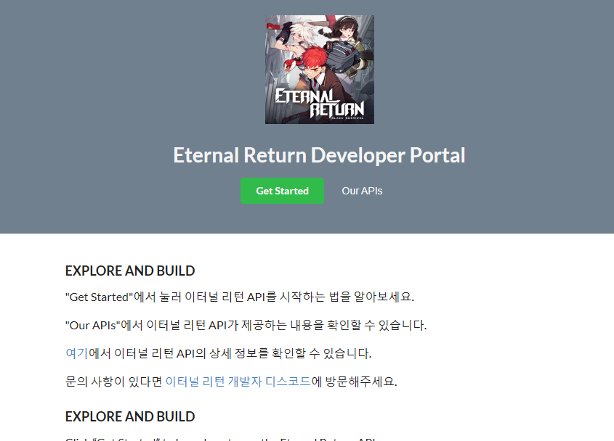
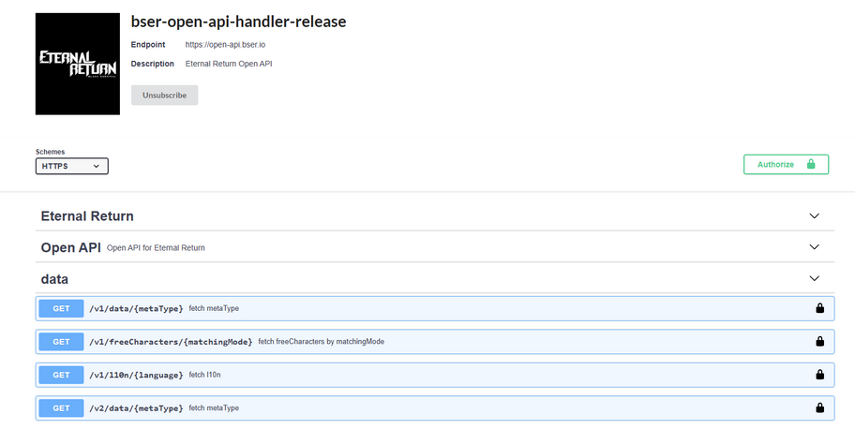
Data Gathering

Slide 7
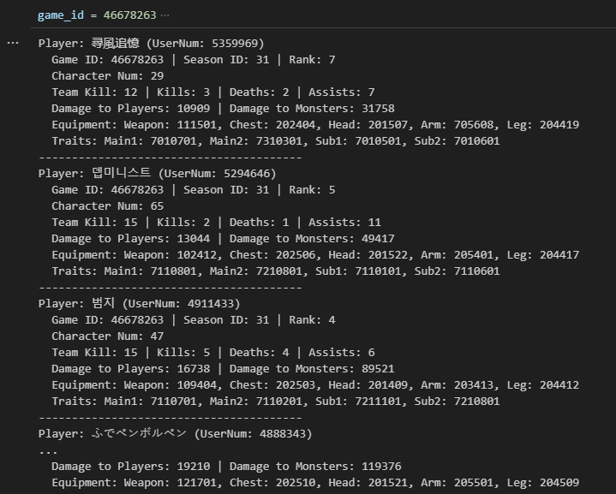
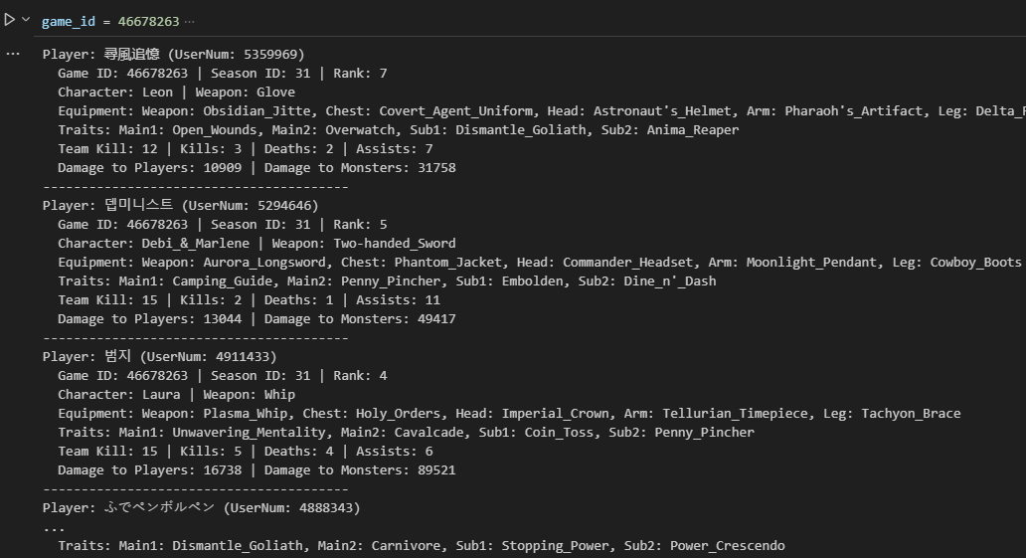
Data Gathering

Slide 8
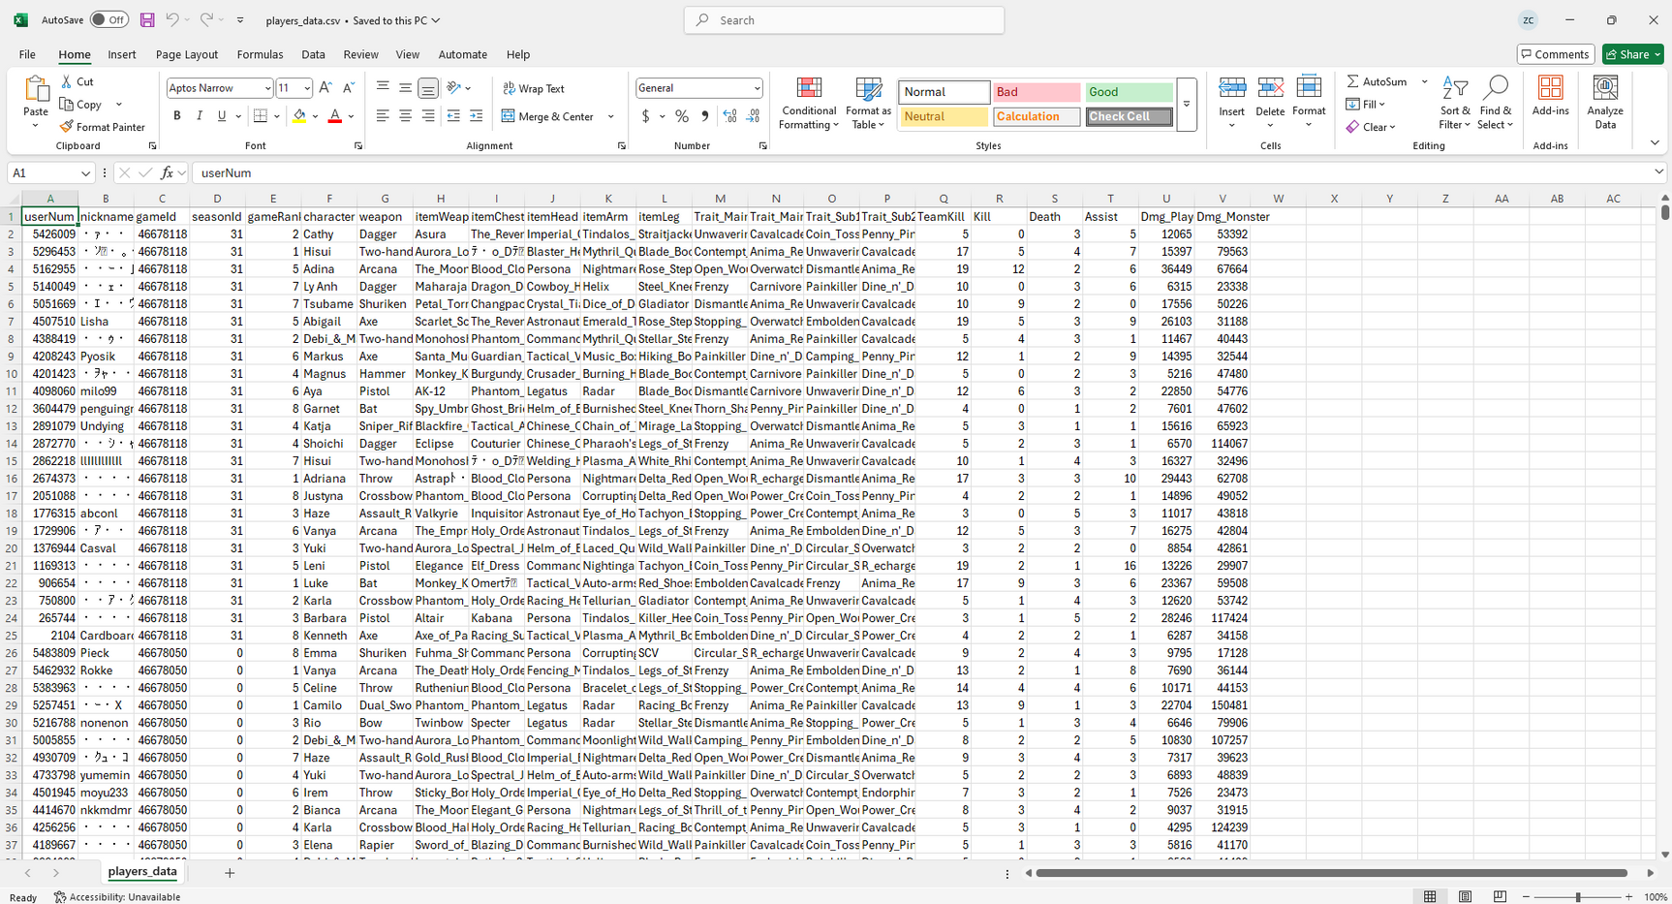
Data Gathering

Slide 9
Model Overview
Dataset
Feature Engineering
Train-Test Split
Preprocessing
Model Training
Evaluation

Slide 10
Models
Classification
Regression
LinearRegression (from sklearn.linear_model)
Ridge (from sklearn.linear_model)
Lasso (from sklearn.linear_model)
ElasticNet (from sklearn.linear_model)
DecisionTreeRegressor (from sklearn.tree)
[USED] RandomForestRegressor (from sklearn.ensemble)
GradientBoostingRegressor (from sklearn.ensemble)
[USED] HistGradientBoostingRegressor (from sklearn.ensemble)
AdaBoostRegressor (from sklearn.ensemble)
ExtraTreesRegressor (from sklearn.ensemble)
XGBRegressor (from xgboost)
LGBMRegressor (from lightgbm)
RandomForestClassifier (from sklearn.ensemble)
GradientBoostingClassifier (from sklearn.ensemble)
AdaBoostClassifier (from sklearn.ensemble)
ExtraTreesClassifier (from sklearn.ensemble)
LogisticRegression (from sklearn.linear_model)
DecisionTreeClassifier (from sklearn.tree)
SVC (from sklearn.svm)
KNeighborsClassifier (from sklearn.neighbors)
XGBClassifier (from xgboost)
[USED] LGBMClassifier (from lightgbm)
Disclaimer: I do not claim full knowledge of the models listed. For the most part, I simply used and evaluated their results.

Slide 11
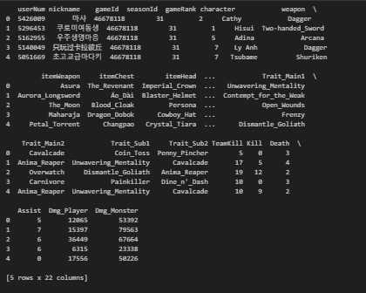
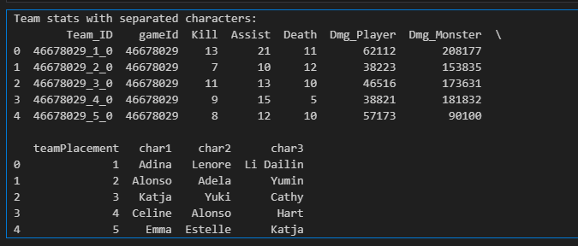
Load dataset
2. Clean data and format dataframe
One row = One player
One row = One team.
TeamWin

Slide 12
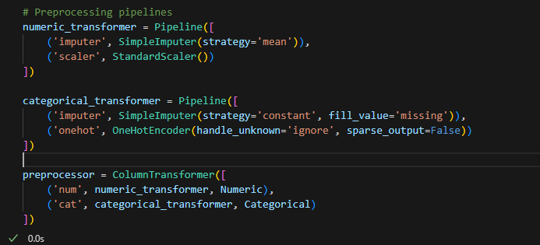
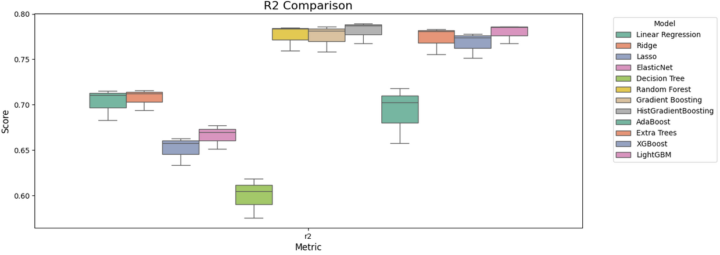
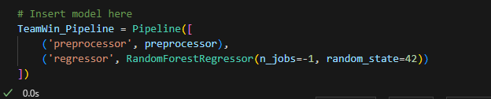
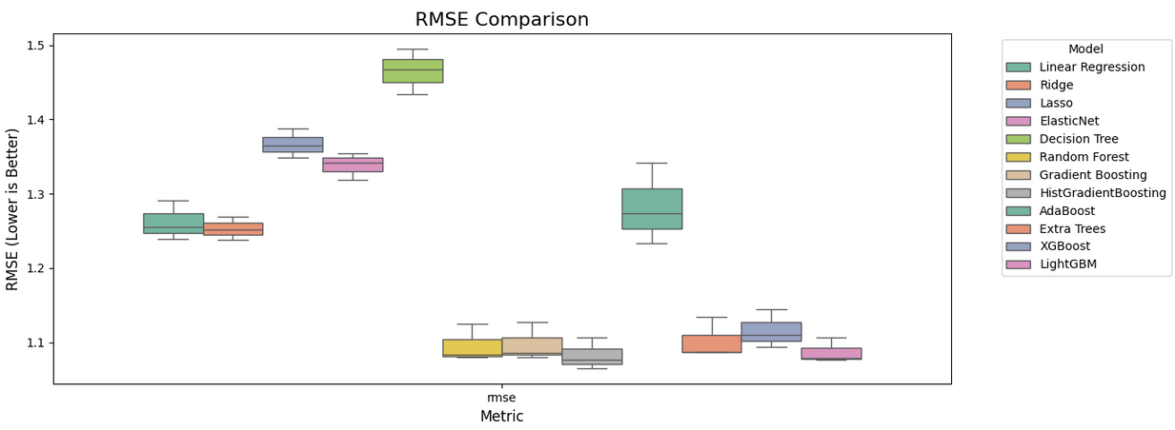
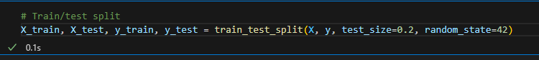
TeamWin
3. Setup pre-processing Pipeline
5. Evaluate Models with sample
4. Train Test Split

Slide 13
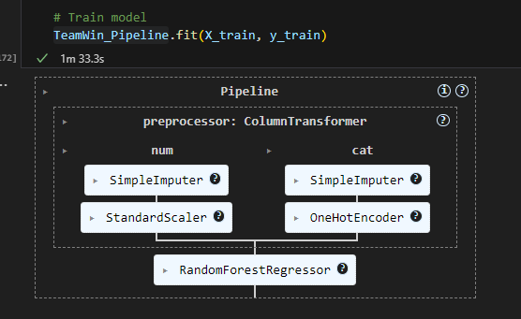
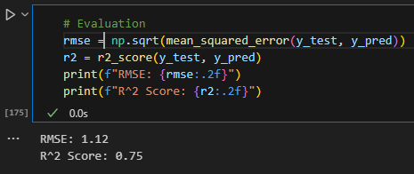
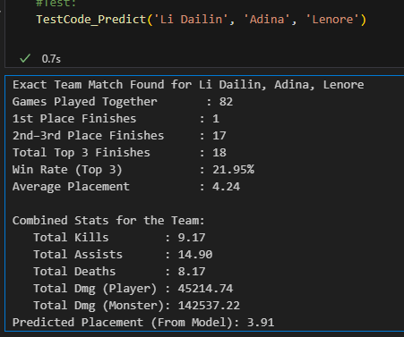
6. fit pipeline with chosen model using full data
7. Evaluate
8. Test
TeamWin

Slide 14
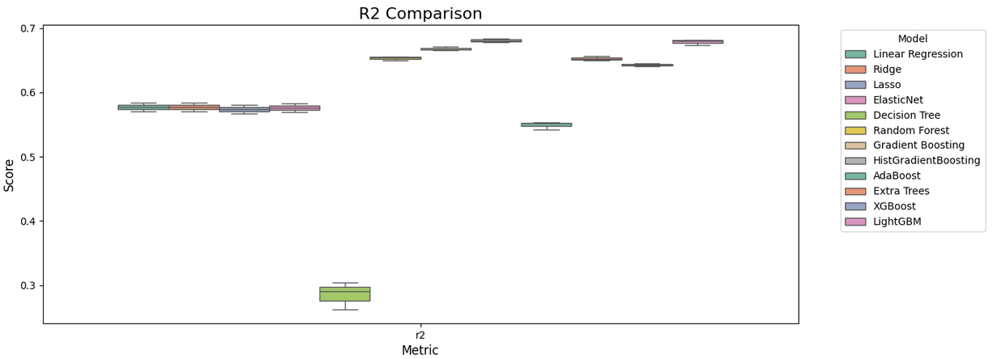
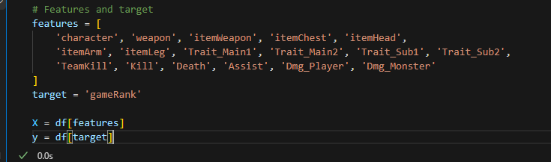
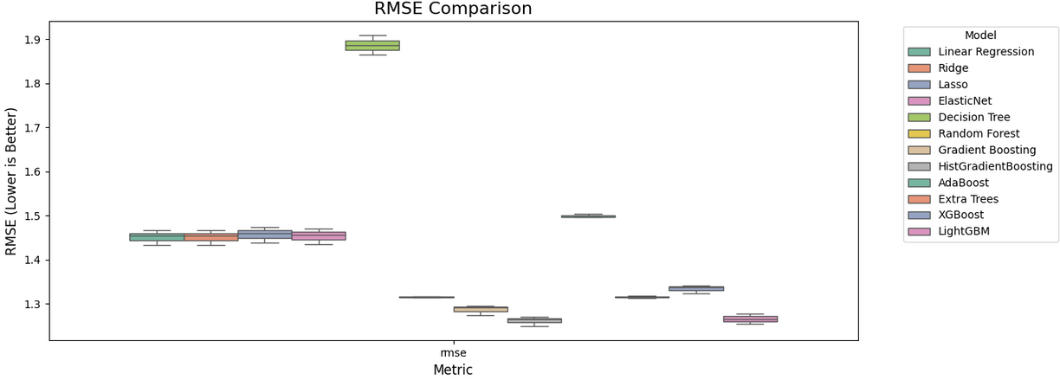
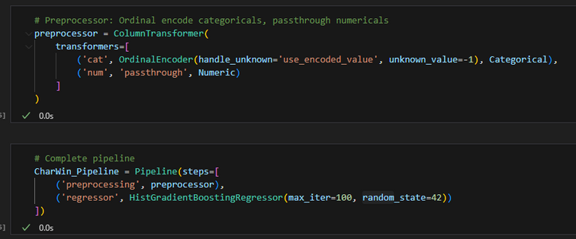
CharWin
5. Train Test Split
Load dataset
6. Evaluate Models with sample
2. Clean Dataset
3. Establish Features and Target
4. Setup Pre-processing Pipeline

Slide 15
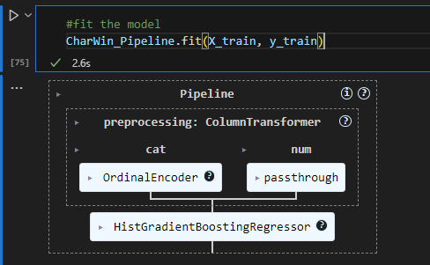
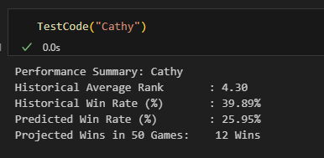
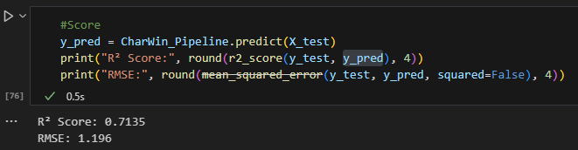
CharWin
7. Fit with chosen model with full data
9. Test
8. Evaluate

Slide 16
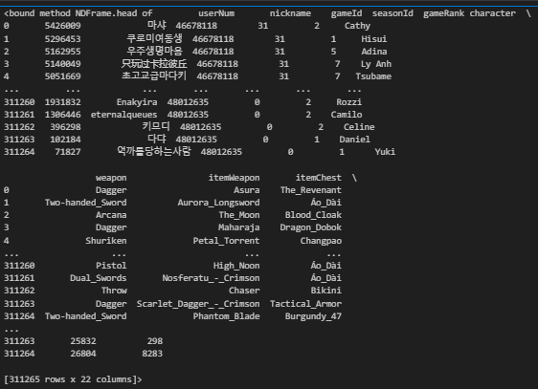
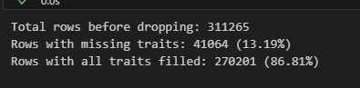
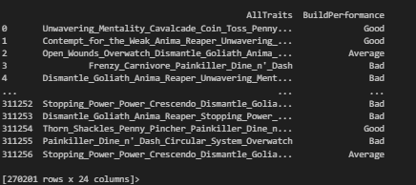
CharBuild
Load data set
2. Clean data and format dataframe

Slide 17
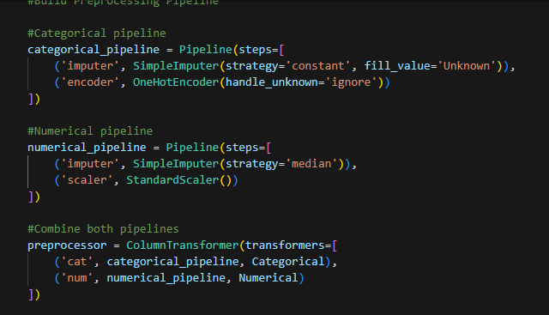
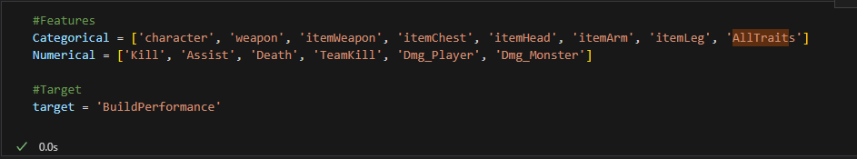
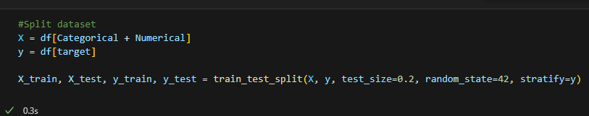
Model Pre-processing
3. Clean data and format dataframe
6. Setup Pre-processing Pipeline
4. Establish target/features
5. Split train test

Slide 18
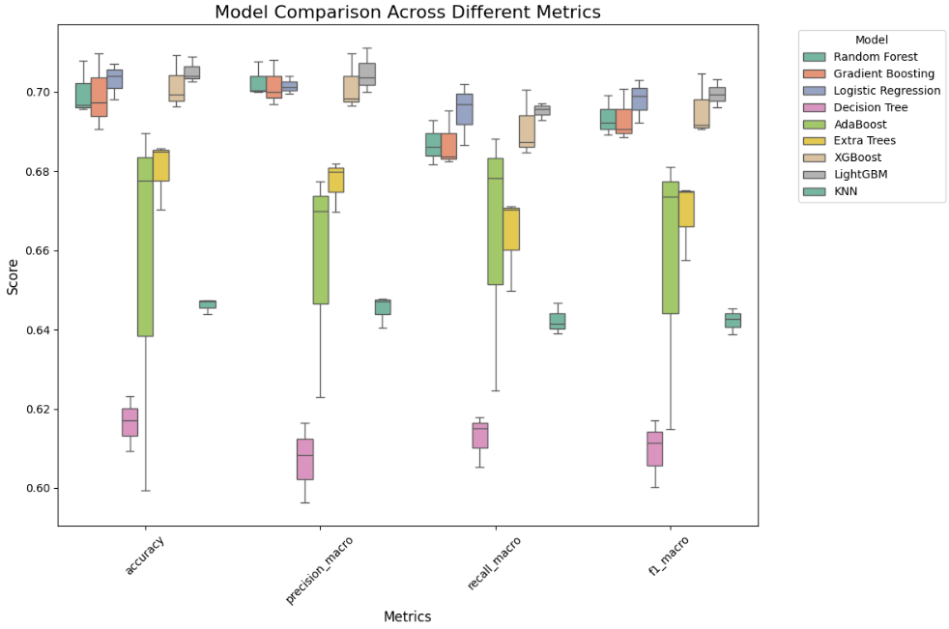
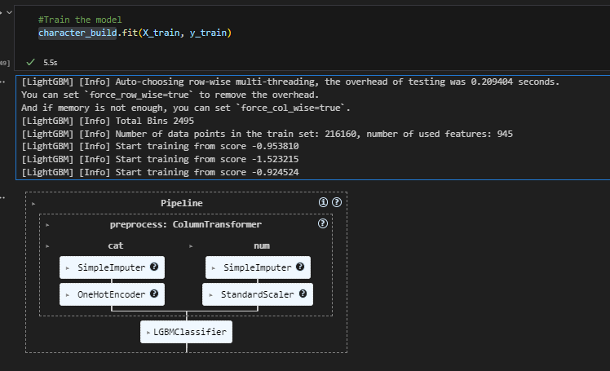
Model Pre-processing
7. Evaluate Models with sample
8. Fit with chosen model with full data

Slide 19
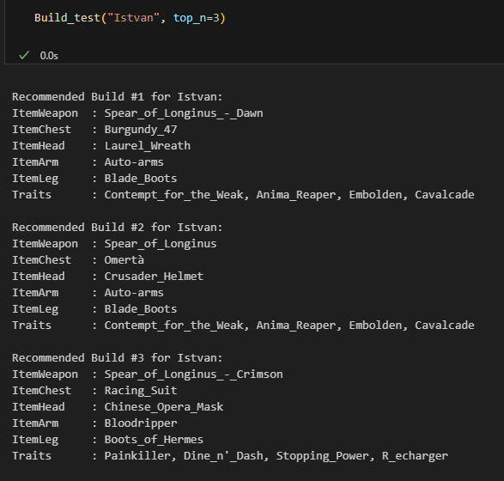
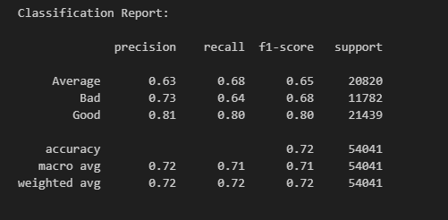
Model Pre-processing
9. Evaluate
10. Test

Slide 20

Conclusion
System predicts builds & team outcomes based on historical match data
The model is heavily skewed by current match trends
Can players improve by learning from high performers
Models are limited by dataset size and parameters
Eternal Return’s appeal is it’s unpredictability.

Slide 21
1
Consider additional performance metrics
Future Work
2
Integrate into a GUI based program
3
Expand Algorithm to more games

Slide 22
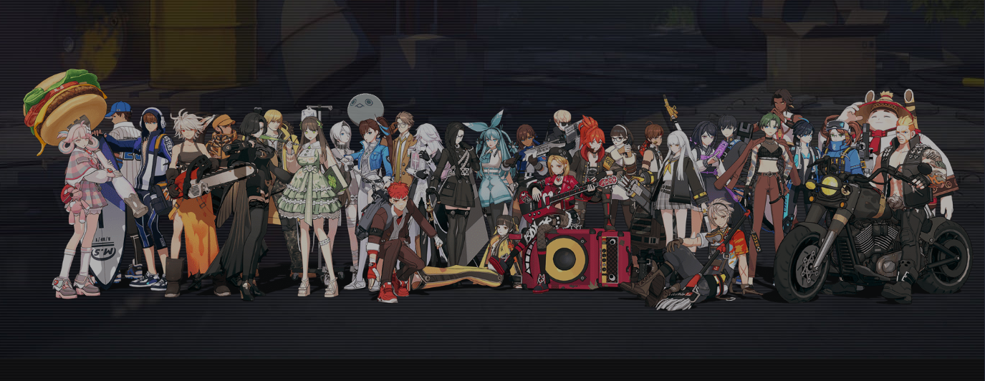
THANK YOU

